Slide 1
Introduction to CVS
Portions adapted from A Visual Guide to Version Control

Slide 2
Outline
Introduction to Source Code Management & CVS
CVS Terminology & Setup
Basic commands
  Checkout, Add, Commit, Diff, Update, Remove, Log, Revert
Other CVS items of interest
  Handling conflicts
  Ignoring certain resources
  Creating your own repositories
  Adding modules to a repository
Popular clients
  TortoiseCVS
  Eclipse
  UNIX shell over SSH

Slide 3
What is Source Code Management
A source code management (SCM) system handles the management of revisions of resources
  Typically, though not always source code
So, why should you use one?

Slide 4
The “I’ll Roll My Own” Approach
You’ve probably seen (or perhaps created) messes like this…
So, what exactly is in Foo.java.bak.bak?
[Dan@icarus grocery-list]$ ls Foo*
Foo.java Foo.java.DAN Foo.java.bak.bak
Foo.java.1030am Foo.java.Sep-2-1030am Foo.java.old
Foo.java.10am Foo.java.WORKING_AS_OF_11am
Foo.java.BROKEN Foo.java.bak
[Dan@icarus grocery-list]$

Slide 5



The “Shared Drive” Approach
Can’t we just write to a directory on the shared drive?
Where’s the eggs developer A added?
  Problem gets worse as number of developers grows
Milk
open
Milk
open
Milk
Milk
Eggs
save
Milk
Eggs
Developer A
save
Developer B
Milk
Juice
Milk
Juice

Slide 6
Use in Industry
Many development shops make use of some type of SCM system where there is a need for more discipline and management of source code
  Can you check to see if class Foo exhibits a particular bug in that release A.B.C from last spring, we made for customer X, for Linux, specifically the i686 build, and if so, what other releases are also affected?
Though there are many different SCM systems out there, the concepts remain pretty similar
  CVS, Subversion, Git, ClearCase, SourceSafe, etc…

Slide 7
What is CVS?
Concurrent Versioning System (CVS) is one of the earlier SCM systems which gained wide adoption
  Open source
  Easy to install and use
  Simple command line client
  Wide integration in a lot of development tools
For good introduction on version control and CVS see the following book…
  Pragmatic Version Control using CVS

Slide 8
CVS Terminology
Repository – the place where resources are stored
Server – the computer hosting the repository
Client – the computer connecting to the repository
Working Set/Copy – your local copy of resources housed in the repository

Slide 9
CVS Terminology
Checkout – pull down resources from the repository and create a working copy
Checkin/Commit – place resources from your working copy into the repository
Add – place a resource under version control
Remove – delete a resource from version control
Update – pull down changes from the repository into your working copy
Revert – overwrite resources in your working copy with what is in the repository

Slide 10
CVS Setup
The following setup/examples assume that you are using a standard CVS command line client and that the repository is accessible directly through the file system
You need to specify where the repository resides, this is typically specified as an environment variable
  bash shell
    export CVSROOT=/path/to/repo
  [t]csh shell
    setenv CVSROOT /path/to/repo
Alternatively, you can specify the path to the repository with the “-d” flag when needed

Slide 11
CVS Command
The general form of CVS commands is:
  All CVS commands start out with “cvs”
  The cvs command must also have a command specified to execute such as “checkout” or “commit”
  Commands may also have flags and/or arguments which modify their behavior
For a more help…
  General help: cvs --help
  List of commands: cvs --help-commands
cvs [cvs-options] command [command-options-and-arguments]

Slide 12
CVS Checkout Command
The “cvs checkout” command is used to checkout code from the repository
The last argument is the name of the module you want to check out
[Dan@icarus code]$ cvs checkout grocery-list
cvs checkout: Updating grocery-list
[Dan@icarus code]$ ls
grocery-list
[Dan@icarus code]$ ls grocery-list/
CVS
[Dan@icarus code]$

Slide 13
CVS Directory
You will note a CVS directory when you check code out
This is a directory that is utilized and managed by the CVS client
  You should not mess with any files within it
  Doing so may cause issues with the CVS client
[Dan@icarus code]$ ls grocery-list/
CVS
[Dan@icarus code]$

Slide 14
Creating Directories and Files
Create directories and edit files using whatever means you want…
[Dan@icarus grocery-list]$ mkdir -p src/edu/umbc/dhood2
[Dan@icarus grocery-list]$ emacs src/edu/umbc/dhood2/GroceryList.java
[Dan@icarus grocery-list]$

Slide 15
Our Example Java File
[Dan@icarus grocery-list]$ cat src/edu/umbc/dhood2/GroceryList.java
package edu.umbc.dhood2;
import java.util.LinkedList;
import java.util.List;
public class GroceryList {
public static void main(String[] args) {
List<String> list = new LinkedList<String>();
list.add("Milk");
for(String item : list) {
System.out.println(item);
}
}
}
[Dan@icarus grocery-list]$

Slide 16
Checking Working Copy Status
You can check the status of your working copy at any time by issuing the “cvs -q update” command…
Here the “?” character means that this is something that is in your working copy, but not under version control
[Dan@icarus grocery-list]$ cvs -q update
? src
[Dan@icarus grocery-list]$ cvs add src/
Directory /srv/cvs/grocery-list/src added to the repository
[Dan@icarus grocery-list]$

Slide 17
Adding Directories to Source Control
To add a directory to source control issue the “cvs add” command
Checking the status now reveals that the “edu” subdirectory under “src” is unknown
  “src” has been added to the repository
  Need to repeat for subdirectories
[Dan@icarus grocery-list]$ cvs add src/
Directory /srv/cvs/grocery-list/src added to the repository
[Dan@icarus grocery-list]$
[Dan@icarus grocery-list]$ cvs -q update
? src/edu
[Dan@icarus grocery-list]$

Slide 18
Adding Files to the Repository
First, you need to register the file as being under version control by using “cvs add” command…
You can verify that it has been added by performing a “cvs -q update”
  The “A” means that it has been added
[Dan@icarus grocery-list]$ cvs add src/edu/umbc/dhood2/GroceryList.java
cvs add: scheduling file `src/edu/umbc/dhood2/GroceryList.java' for addition
cvs add: use 'cvs commit' to add this file permanently
[Dan@icarus grocery-list]$
[Dan@icarus grocery-list]$ cvs -q update
A src/edu/umbc/dhood2/GroceryList.java
[Dan@icarus grocery-list]$

Slide 19
Committing Changes
Files that have been added your working copy can be committed to the repository with “cvs commit”…
  The “-m” flag can be used to enter a message, otherwise the editor specified with the CVSEDITOR environment variable is used to author a message (or a default editor is used)
[Dan@icarus grocery-list]$ cvs commit -m 'initial list'
cvs commit: Examining .
cvs commit: Examining src
cvs commit: Examining src/edu
cvs commit: Examining src/edu/umbc
cvs commit: Examining src/edu/umbc/dhood2
RCS file: /srv/cvs/grocery-list/src/edu/umbc/dhood2/GroceryList.java,v
done
Checking in src/edu/umbc/dhood2/GroceryList.java;
/srv/cvs/grocery-list/src/edu/umbc/dhood2/GroceryList.java,v <-- GroceryList.java
initial revision: 1.1
done
[Dan@icarus grocery-list]$

Slide 20
Diffing Files Against the Repository
You can easily check what changes have been made to a file by using the “cvs diff -u” command…
  Here another line of code (marked with a “+” has been added)
[Dan@icarus grocery-list]$ cvs diff -u src/edu/umbc/dhood2/GroceryList.java
Index: src/edu/umbc/dhood2/GroceryList.java
===================================================================
RCS file: /srv/cvs/grocery-list/src/edu/umbc/dhood2/GroceryList.java,v
retrieving revision 1.1
diff -u -r1.1 GroceryList.java
--- src/edu/umbc/dhood2/GroceryList.java 26 Aug 2008 14:15:45 -0000 1.1
+++ src/edu/umbc/dhood2/GroceryList.java 26 Aug 2008 14:21:02 -0000
@@ -9,6 +9,7 @@
List<String> list = new LinkedList<String>();
list.add("Milk");
+ list.add("Eggs");
for(String item : list) {
System.out.println(item);
[Dan@icarus grocery-list]$

Slide 21
Committing Changes to Existing Files
Committing updates you have made to files in your working copy (already added to the repository) is very easy, just perform another commit…
[Dan@icarus grocery-list]$ cvs commit -m 'added eggs to list'
cvs commit: Examining .
cvs commit: Examining src
cvs commit: Examining src/edu
cvs commit: Examining src/edu/umbc
cvs commit: Examining src/edu/umbc/dhood2
Checking in src/edu/umbc/dhood2/GroceryList.java;
/srv/cvs/grocery-list/src/edu/umbc/dhood2/GroceryList.java,v <-- GroceryList.java
new revision: 1.2; previous revision: 1.1
done
[Dan@icarus grocery-list]$

Slide 22
Getting Updates
If updates have been committed to the repository and you need to pull them down into your working copy, issue a “cvs update -d” command…
  The “U” indicates that the file has been updated
[Dan@daedalus grocery-list]$ cvs update
cvs update: Updating .
cvs update: Updating src
cvs update: Updating src/edu
cvs update: Updating src/edu/umbc
cvs update: Updating src/edu/umbc/dhood2
U src/edu/umbc/dhood2/GroceryList.java
[Dan@daedalus grocery-list]$

Slide 23
Inadvertent Adds
If you inadvertently add a file using a “cvs add” and have not committed that file to the repository it can simply be removed via a “cvs remove -f” command…
  The “-f” flag deletes the file as well
[Dan@icarus grocery-list]$ cvs add src/edu/umbc/dhood2/*
cvs add: cannot add a `CVS' directory
cvs add: src/edu/umbc/dhood2/GroceryList.java already exists, with version number 1.2
cvs add: scheduling file `src/edu/umbc/dhood2/GroceryList.java~' for addition
cvs add: use 'cvs commit' to add this file permanently
[Dan@icarus grocery-list]$ cvs -q update
A src/edu/umbc/dhood2/GroceryList.java~
[Dan@icarus grocery-list]$
[Dan@icarus grocery-list]$ cvs remove -f src/edu/umbc/dhood2/GroceryList.java~
cvs remove: removed `src/edu/umbc/dhood2/GroceryList.java~'
[Dan@icarus grocery-list]$ cvs -q update
[Dan@icarus grocery-list]$

Slide 24
Inadvertent Adds (continued)
If you have already committed the file to the repository you will need to perform another commit (the remove command will let you know if you need to)…
[Dan@icarus grocery-list]$ cvs remove -f src/edu/umbc/dhood2/GroceryList.java~
cvs remove: scheduling `src/edu/umbc/dhood2/GroceryList.java~' for removal
cvs remove: use 'cvs commit' to remove this file permanently
[Dan@icarus grocery-list]$ cvs commit -m 'deleted accidental commit'
cvs commit: Examining .
cvs commit: Examining src
cvs commit: Examining src/edu
cvs commit: Examining src/edu/umbc
cvs commit: Examining src/edu/umbc/dhood2
Removing src/edu/umbc/dhood2/GroceryList.java~;
/srv/cvs/grocery-list/src/edu/umbc/dhood2/GroceryList.java~,v <-- GroceryList.java~
new revision: delete; previous revision: 1.1
done
[Dan@icarus grocery-list]$

Slide 25
Getting Information on a Resource
If you want to see the history for a file, you can use the “cvs log” command to get back the date/time of commits as well as the committal messages…
[Dan@icarus grocery-list]$ cvs log src/edu/umbc/dhood2/GroceryList.java
RCS file: /srv/cvs/grocery-list/src/edu/umbc/dhood2/GroceryList.java,v
Working file: src/edu/umbc/dhood2/GroceryList.java
head: 1.2
branch:
locks: strict
access list:
symbolic names:
keyword substitution: kv
total revisions: 2; selected revisions: 2
description:
----------------------------
revision 1.2
date: 2008/08/24 14:23:25; author: Dan; state: Exp; lines: +1 -0
added eggs to list
----------------------------
revision 1.1
date: 2008/08/24 14:15:45; author: Dan; state: Exp;
initial list
=============================================================================
[Dan@icarus grocery-list]$

Slide 26
Abandoning Changed Files
If you really messed up your local copy of a file and want to have the latest version back from the repository instead, simply delete the file and re-update…
[Dan@icarus grocery-list]$ cvs -q update
M src/edu/umbc/dhood2/GroceryList.java
[Dan@icarus grocery-list]$ rm src/edu/umbc/dhood2/GroceryList.java
[Dan@icarus grocery-list]$ cvs -q update
cvs update: warning: src/edu/umbc/dhood2/GroceryList.java was lost
U src/edu/umbc/dhood2/GroceryList.java
[Dan@icarus grocery-list]$

Slide 27
Handling Conflicts
What happens in our previous scenario when developer B tried to commit?
Milk
open
Milk
open
Milk
Milk
Eggs
save
Milk
Eggs
Developer A
save
Developer B
Milk
Juice
Milk
Juice

Slide 28
Handling Conflicts (continued)
If we try to commit these changes CVS detects a conflict…
  Both the working copy and the repository have changes since last update
[Dan@daedalus grocery-list]$ cvs commit -m 'added juice'
cvs commit: Examining .
cvs commit: Examining src
cvs commit: Examining src/edu
cvs commit: Examining src/edu/umbc
cvs commit: Examining src/edu/umbc/dhood2
cvs commit: Up-to-date check failed for `src/edu/umbc/dhood2/GroceryList.java'
cvs [commit aborted]: correct above errors first!
[Dan@daedalus grocery-list]$

Slide 29
Handling Conflicts (continued)
So, we need to do an update…
[Dan@daedalus grocery-list]$ cvs update -d
cvs update: Updating .
cvs update: Updating src
cvs update: Updating src/edu
cvs update: Updating src/edu/umbc
cvs update: Updating src/edu/umbc/dhood2
RCS file: /srv/cvs/grocery-list/src/edu/umbc/dhood2/GroceryList.java,v
retrieving revision 1.1
retrieving revision 1.2
Merging differences between 1.1 and 1.2 into GroceryList.java
rcsmerge: warning: conflicts during merge
cvs update: conflicts found in src/edu/umbc/dhood2/GroceryList.java
C src/edu/umbc/dhood2/GroceryList.java
[Dan@daedalus grocery-list]$

Slide 30
Handling Conflicts (continued)
The file then looks like, we need to fix it…
[Dan@daedalus grocery-list]$ cat src/edu/umbc/dhood2/GroceryList.java
package edu.umbc.dhood2;
import java.util.LinkedList;
import java.util.List;
public class GroceryList {
public static void main(String[] args) {
List<String> list = new LinkedList<String>();
list.add("Milk");
<<<<<<< GroceryList.java
list.add("Juice");
=======
list.add("Eggs");
>>>>>>> 1.2
for(String item : list) {
System.out.println(item);
}
}
}
[Dan@daedalus grocery-list]$

Slide 31
Handling Conflicts (continued)
Once resolved, we can then commit the changes back to the repository…
[Dan@daedalus grocery-list]$ cvs commit -m 'added juice'
cvs commit: Examining .
cvs commit: Examining src
cvs commit: Examining src/edu
cvs commit: Examining src/edu/umbc
cvs commit: Examining src/edu/umbc/dhood2
Checking in src/edu/umbc/dhood2/GroceryList.java;
/srv/cvs/grocery-list/src/edu/umbc/dhood2/GroceryList.java,v <-- GroceryList.java
new revision: 1.3; previous revision: 1.2
done
[Dan@daedalus grocery-list]$

Slide 32
Ignoring Specific Resources
Most people do not check in certain resources such as .class files and other generated artifacts
We can “blacklist” them by adding the name of the resource to ignore to a file called “.cvsignore” in that directory

Slide 33
Ignoring Specific Resources (continued)
Without a .cvsignore file (bin contains the compiled form of the src directory)
With a .cvsignore file…
[Dan@daedalus grocery-list]$ cvs -q update
? bin
[Dan@daedalus grocery-list]$
[Dan@daedalus grocery-list]$ cat .cvsignore
bin
[Dan@daedalus grocery-list]$ cvs -q update
? .cvsignore
[Dan@daedalus grocery-list]$

Slide 34
Ignoring Specific Resources (continued)
The contents of the .cvsignore file…
After committing…
[Dan@daedalus grocery-list]$ cat .cvsignore
bin
[Dan@daedalus grocery-list]$
[Dan@daedalus grocery-list]$ cvs add .cvsignore
cvs add: scheduling file `.cvsignore' for addition
cvs add: use 'cvs commit' to add this file permanently
[Dan@daedalus grocery-list]$ cvs commit -m 'added ignores'
cvs commit: Examining .
cvs commit: Examining src
cvs commit: Examining src/edu
cvs commit: Examining src/edu/umbc
cvs commit: Examining src/edu/umbc/dhood2
RCS file: /srv/cvs/grocery-list/.cvsignore,v
done
Checking in .cvsignore;
/srv/cvs/grocery-list/.cvsignore,v <-- .cvsignore
initial revision: 1.1
done
[Dan@daedalus grocery-list]$ cvs -q update
[Dan@daedalus grocery-list]$

Slide 35
Creating Your Own Repository
One reason that CVS is popular is it’s ease of install
If you want a repository, all you need to do is make a directory, set the CVSROOT environment variable and run “cvs init”
[Dan@icarus code]$ mkdir -p /srv/cvs
[Dan@icarus code]$ export CVSROOT=/srv/cvs
[Dan@icarus code]$ cvs init
[Dan@icarus code]$ ls /srv/cvs/
CVSROOT
[Dan@icarus code]$

Slide 36
Adding Modules to a Repository
You can add modules to a repository via a “cvs import” command..
  Usage is “cvs import <module name> <vendor tag> <initial tag>”
Note: this imports the code only – you will now need to check it out of the repository in order to perform cvs operations against it
[Dan@icarus code]$ cd grocery-list/
[Dan@icarus grocery-list]$ cvs import -m 'initial import' grocery-list personal start
No conflicts created by this import
[Dan@icarus grocery-list]$

Slide 37

TortoiseCVS
TortoiseCVS is a popular Windows based CVS client
TortoiseCVS integrates directly with Windows Explorer allowing you to perform CVS operations from context menus
You can get it free at:
  http://www.tortoisecvs.org/
(The following directions are for a default installation of TortoiseCVS-1.10.7.exe)

Slide 38
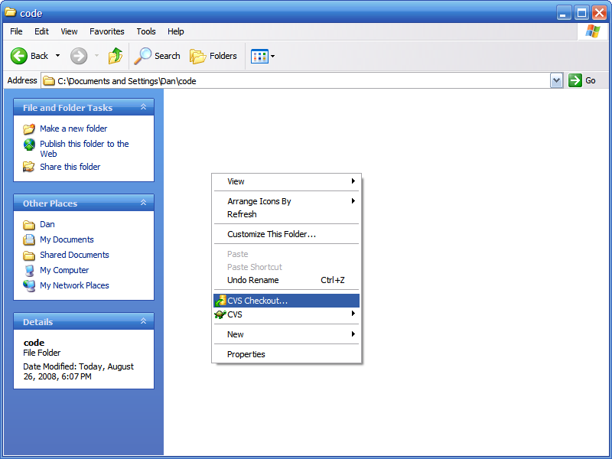
TortoiseCVS – Checkout
Right click in Explorer and select “CVS Checkout…” from the menu of options

Slide 39
TortoiseCVS – Connection Settings
Type in the parameters to connect to the remote repository
For example…
  Protocol: Secure Shell
  Server: linux[123].gl.umbc.edu (1, 2 or 3)
  Repository: /afs/umbc.edu/users/o/a/oates/pub/cs341f08/Proj0
  User name: Your GL/myUMBC username
  Module: Your GL/myUMBC username

Slide 40
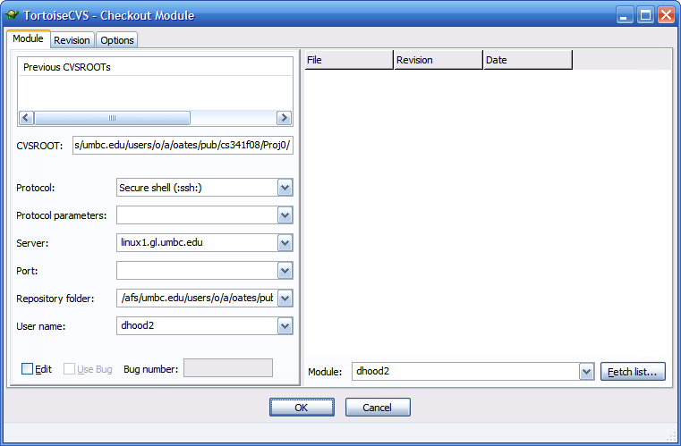
TortoiseCVS – Connection Settings

Slide 41
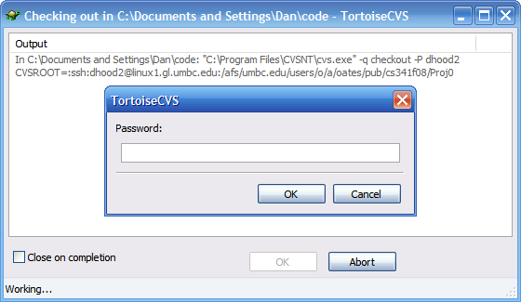
TortoiseCVS – Connecting
When trying to connect you will be prompted for your GL/myUMBC password

Slide 42
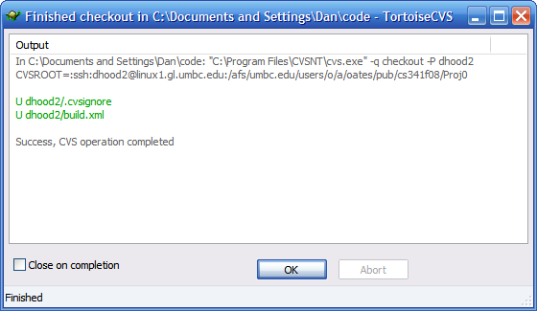
TortoiseCVS – Checkout
In the console, you should see similar logs to that of a text based client, if all goes well you will see “Success”

Slide 43
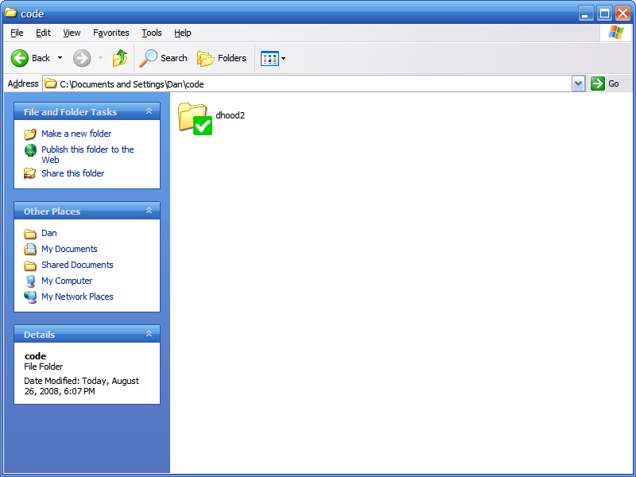
TortoiseCVS – Checked Out
TortoiseCVS will put an icon over the resource in Explorer to indicate the status against the repository
  As you can see, the checkout went okay…

Slide 44
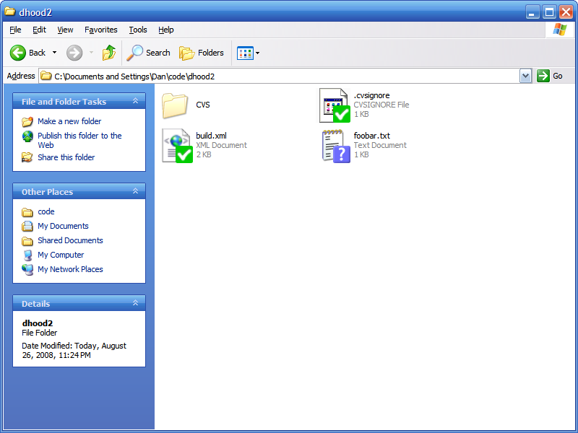
TortoiseCVS – Modified File
Here we’ve create a new file called foobar.txt…
  Modified files are marked with a “?” just like the text based version does when doing an update

Slide 45
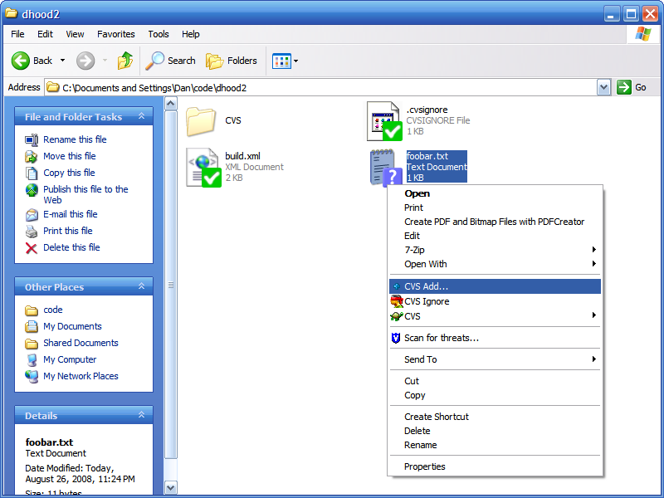
TortoiseCVS – Adding to CVS
To add a resource to CVS right click and choose “CVS Add…”

Slide 46
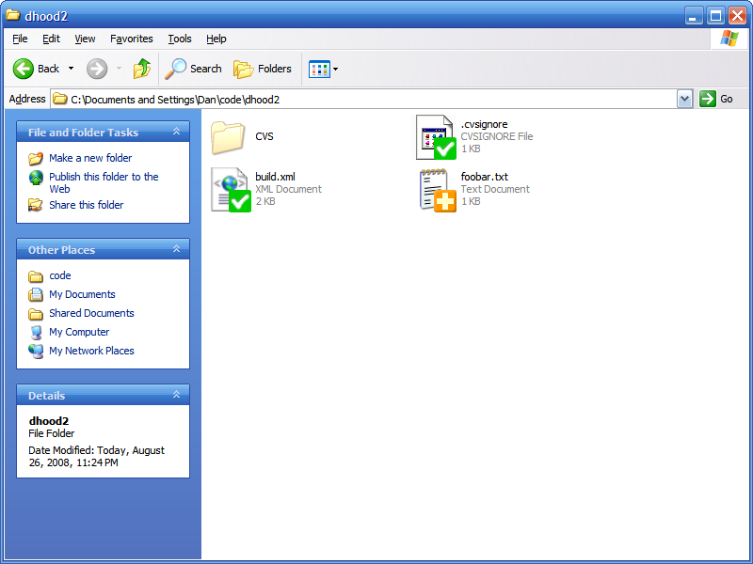
TortoiseCVS – Added to CVS
Here you can see that the symbol has been changed to a plus, as it’s now under control…

Slide 47
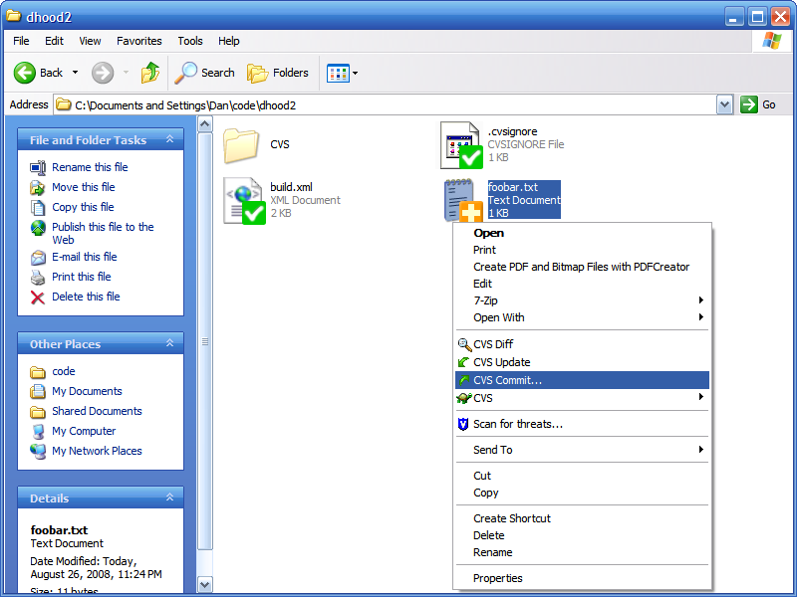
TortoiseCVS – Committing a Resource
To commit a resource, again right click and choose “CVS Commit…”

Slide 48
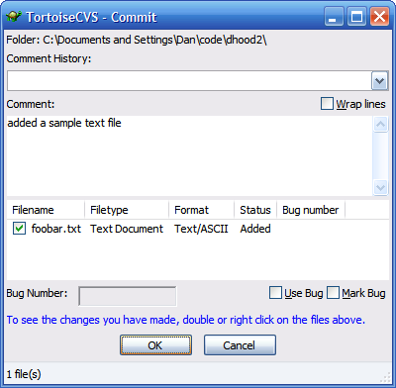
TortoiseCVS – Committing a Resource
Here you see the build in commit editor to comment about newly committed resources…

Slide 49

TortoiseCVS – File Checked In
Once checked in TortoiseCVS will flip the icon to the green check to let us know that it has been committed and not modified…

Slide 50

TortoiseCVS – Modified Files
If you modify a file, it will be flagged with a yellow arrow indicating that it is pending committal…

Slide 51
TortoiseCVS
For help and more documentation see…
  FAQ:
    http://www.tortoisecvs.org/faq.shtml
  User’s Guide:
    http://www.tortoisecvs.org/UserGuide_en.chm

Slide 52

Eclipse
Eclipse has a built-in perspective for CVS
  All of the developer downloads come with it pre-installed
(The following directions are for the Eclipse Ganymede Eclipse IDE for Java Developer release)

Slide 53
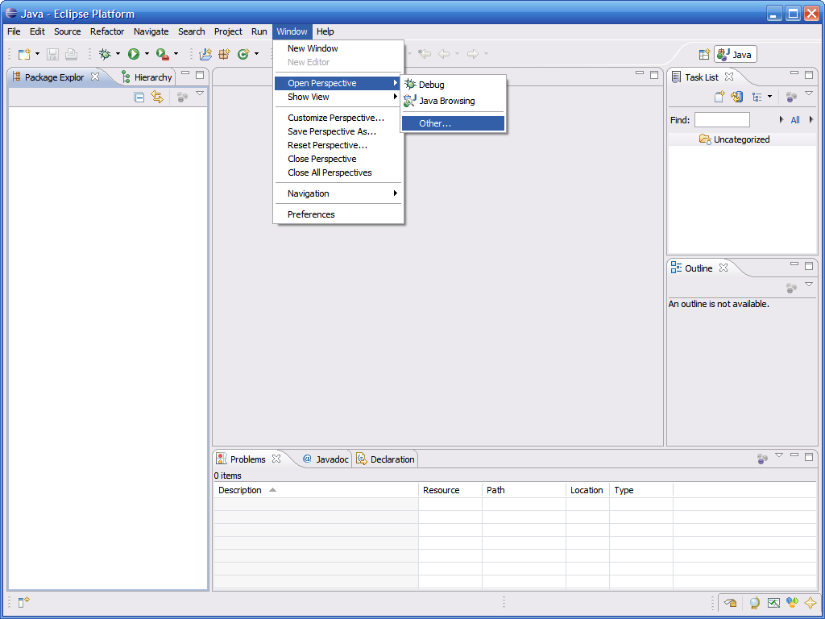
Eclipse – CVS Perspective
To open the CVS repository perspective select Window → Open Perspective → Other…

Slide 54
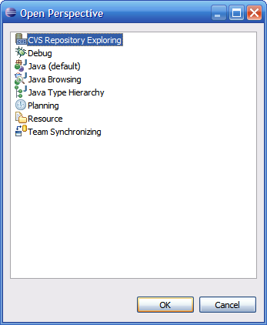
Eclipse – CVS Perspective
Select CVS Repository Exploring

Slide 55
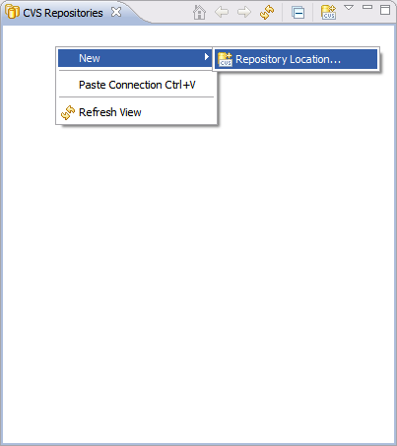
Eclipse – Adding a Repository
To add a repository, right click on the CVS Repositories pane and select New → Repository Location…

Slide 56
Eclipse – Connection Settings
Type in the parameters to connect to the remote repository
For example…
  Host: linux.gl.umbc.edu
  Repository Path: /afs/umbc.edu/users/o/a/oates/pub/cs341f08/Proj0
  User: Your GL/myUMBC username
  Password: Your GL/myUMBC password
  Connection type: extssh
Save the password if you wish

Slide 57
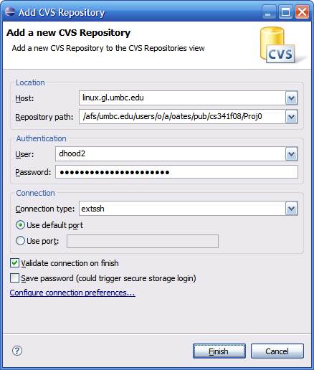
Eclipse – Connection Settings

Slide 58
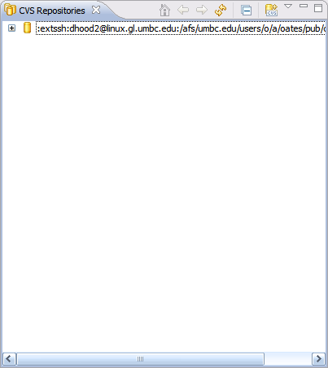
Eclipse – Viewing Repositories
You should now see the repository under the CVS Repositories Pane

Slide 59
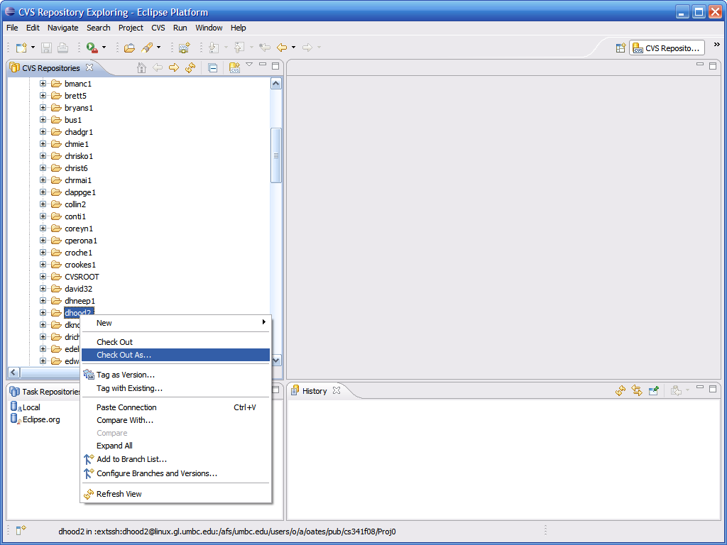
Eclipse – Checking Out
Expand the repository, expand HEAD, select your module (username) then right click and choose Check Out As…

Slide 60
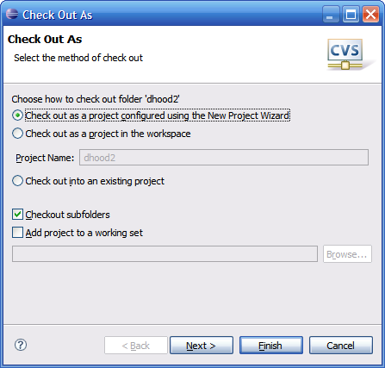
Eclipse – Checking Out (continued)
Be sure to use the New Project Wizard, click Finish…

Slide 61
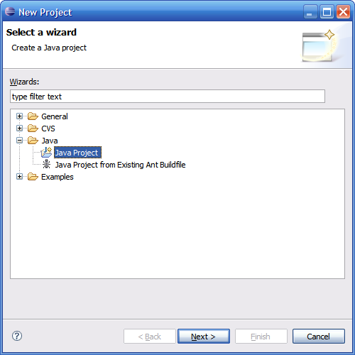
Eclipse – Checking Out (continued)
Select to check out the module as a Java Project

Slide 62
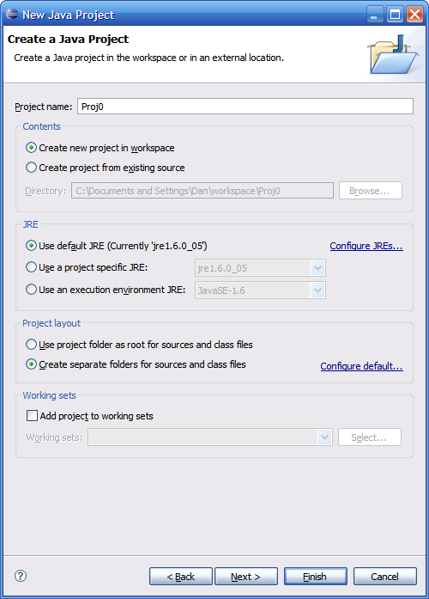
Eclipse – Checking Out (continued)
Name the project and click Finish…

Slide 63
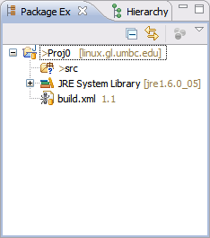
Eclipse – Checked Out Code
Switch back to the Java Perspective and you will see the module checked out as a project
  Note the little orange cylinders – that indicates that it’s under version control

Slide 64
Eclipse – New Resources
Just like with the command line, items that are not know to be under CVS control are marked with a “?” symbol
  Such as the Eclipse generated src folder

Slide 65
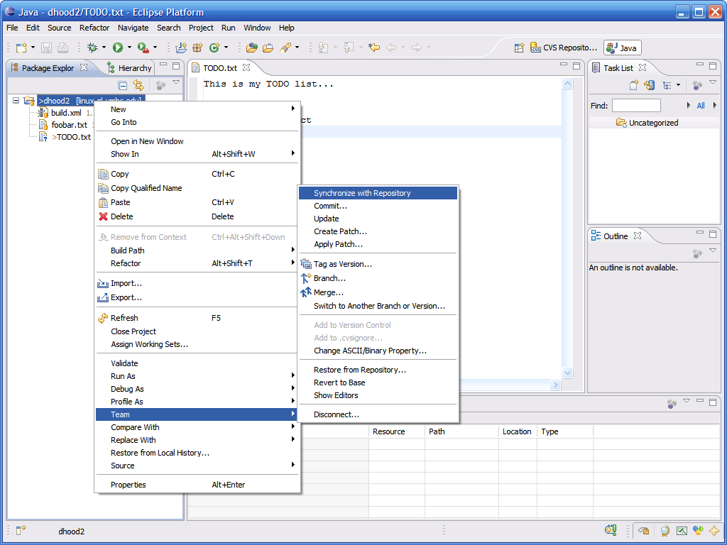
Eclipse – Synchronizing
To commit to or update from the repository, right click on the project and choose Team → Synchronize with Repository

Slide 66
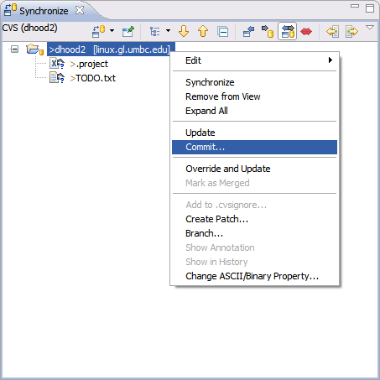
Eclipse – Committing Resources
Here we see an outgoing arrow indicating that this needs to be pushed to the repository
  Commits and updates can be performed by right clicking

Slide 67
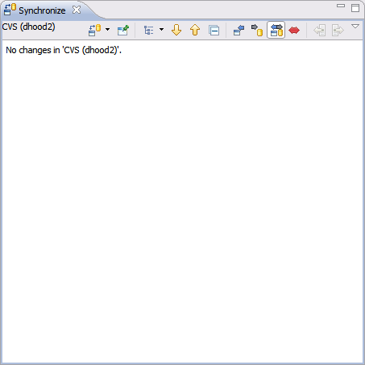
Eclipse – Synchronized
If all is in sync, you should see the “No Changes” dialog as shown below…

Slide 68
UNIX Shell Over SSH
If you are connecting from a UNIX-like machine, then you probably have everything you need to access the repository remotely
  Most UNIX-like OS’s come with a command line cvs and ssh suite
  You can easily configure cvs to use ssh to connect to a remote repository

Slide 69
UNIX Shell Over SSH
The key is how 2 environment variables are setup…
  CVS_RSH – this tells CVS what protocol to use if a remote server is specified (note this is usually the default, so you probably do not need to explicitly set it)
    bash shell
      export CVS_RSH=ssh
    [t]csh shell
      setenv CVSROOT ssh
  CVSROOT – needs to specify a user at a remote host (similar syntax to SCP)
    bash shell
      export CVSROOT=username@linux.gl.umbc.edu:/path/to/repo
    [t]csh shell
      setenv CVSROOT username@linux.gl.umbc.edu:/path/to/repo

Slide 70
UNIX Shell Over SSH (checkout)
[dan@icarus code]$ export CVS_RSH=ssh
[dan@icarus code]$ export CVSROOT=dhood2@linux.gl.umbc.edu:/afs/umbc.edu/users/o/a/oates/pub/cs341f08/Proj0
[dan@icarus code]$ cvs checkout -d Proj0 dhood2
WARNING: UNAUTHORIZED ACCESS to this computer is in violation of Criminal
Law Article section 8-606 and 7-302 of the Annotated Code of MD.
NOTICE: This system is for the use of authorized users only.
Individuals using this computer system without authority, or in
excess of their authority, are subject to having all of their
activities on this system monitored and recorded by system
personnel.
dhood2@linux.gl.umbc.edu's password:
cvs checkout: Updating Proj0
U Proj0/.cvsignore
[dan@icarus code]$

